Slide 1

Python Project
TITLE: Password Generator
Name: Shaik Abdul Khader Jilani
Section: K23CH
Registration No: 12316430
Roll No: 66
Submitted To:
Aman Kumar

Slide 2

Password Generator: Secure and Efficient
This innovative solution seamlessly blends robust security measures, user-friendly design, and high performance. Discover its overview, architecture, key features, implementation highlights, and future scope in the following slides.

Slide 3

Overview of the Application
Purpose
Key Features
Target Audience
Our Password Generator is a user-friendly tool that creates strong, unique passwords to enhance online security.
Customizable password length, character set, and password strength metering.
Individuals and businesses seeking to improve their password management and security.

Slide 4

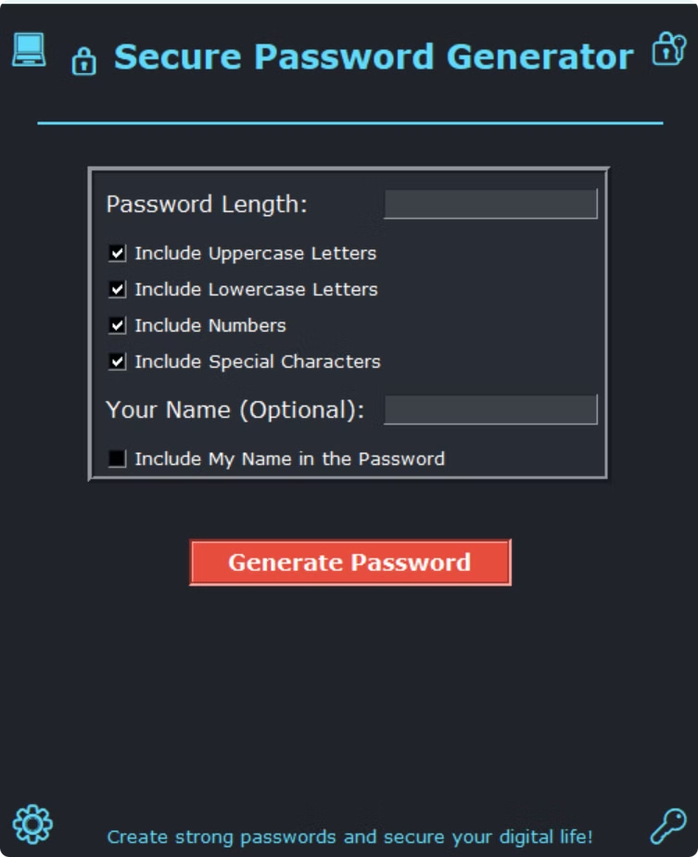

Application Architecture and Components
1
User Interface
Developed using Tkinter, a Python GUI toolkit, for a responsive and intuitive user experience.
2
Password Generation Logic
Custom algorithms and character sets to create strong, random passwords based on user preferences.
3
Password Strength Evaluation
Integrated password strength metering to provide real-time feedback on password security.

Slide 5




Frameworks and Technologies Used
Development Environment
Tkinter
The primary python programming language used for the application's development in Jupyter notebook
The GUI toolkit used to create the user interface.
Random Module
Password Strength Evaluation
Utilized for generating random and secure passwords.
Implemented custom algorithms to assess password security.

Slide 6

Core Functionalities of the Password Generator
1
Password Generation
2
Password Strength Metering
Users can specify the desired password length and character set, and the application will generate a unique, secure password.
The application provides real-time feedback on the strength of the generated password, helping users create stronger passwords.
3
Password Display and Clipboard Integration
The generated password can be displayed and easily copied to the clipboard for convenient use.

Slide 7
Implementation Highlights
Modular Design
Randomness and Security
The application's architecture follows a modular design, making it easy to maintain, update, and extend with new features.
The password generation algorithm uses a combination of techniques to ensure the highest level of randomness and security.
User-Friendly Interface
Extensibility
The Tkinter-based user interface is intuitive and responsive, providing a seamless user experience.
The modular design and flexible architecture allow for future enhancements and integration with other systems.

Slide 8
Code and Functional Details
1
Password Generation
The password generation module uses a combination of the random module and custom character sets to create unique, secure passwords.
2
Password Strength Evaluation
The strength evaluation module analyzes the generated password based on factors like length, character diversity, and entropy to provide a security score.
3
User Interface Integration
The Tkinter-based user interface seamlessly integrates with the password generation and evaluation modules, allowing for real-time updates and user interactions.

Slide 9



Conclusion and Future Scope
Conclusion
Our Password Generator application provides a secure and efficient solution for creating strong, unique passwords, empowering users to enhance their online security.
1
Future Scope
2
Planned enhancements include password management features, integration with cloud-based storage, and support for multi-factor authentication.
Key Takeaways
3
Secure password management is crucial in the digital age, and our application demonstrates the value of combining user-friendly design with robust security measures.

